Slide 1

Predicting Rainfall: LSTM Applications in Time Series Forecasting
By Aman Adukoorie

Slide 2
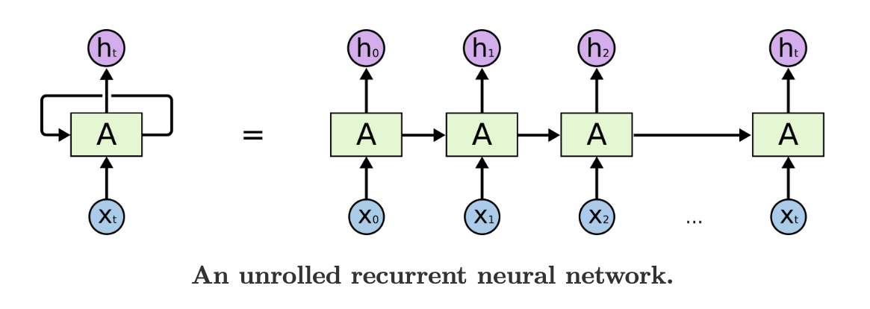
Introduction to RNNs
Recurrent Neural Networks (RNNs) are designed to recognize patterns in sequences of data, they have internal memory, allowing them, in theory, to learn long term dependencies in data.
In practice, we observe a vanishing gradient problem. During back propagation the gradient of the loss gets concentrated in a fews parameters and goes to zero for the rest.

Slide 3
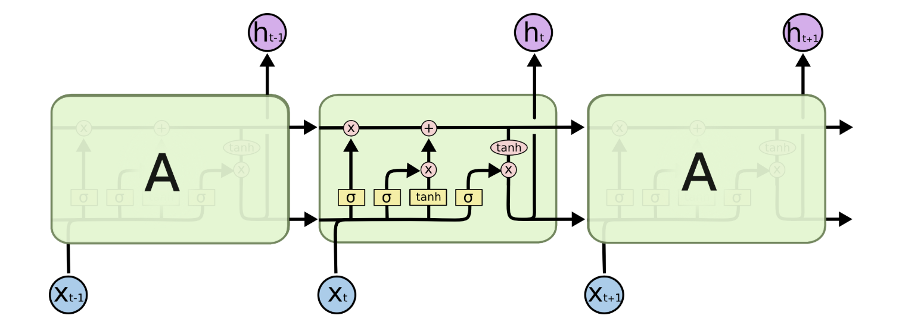
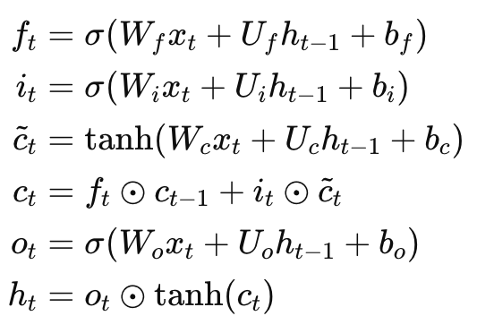
LSTM Network Architecture
Long Short-Term Memory (LSTM) networks were introduced in 1997 by Hochreiter and Schmidhuber, specifically designed to address the vanishing gradient problem inherent in traditional RNNs.
LSTMs overcome the vanishing gradient through an architecture that includes a "memory cell" and specialized "gates." These gates—the input, forget, and output gates—regulate the flow of information into, out of, and within the memory cell, enabling LSTMs to selectively remember or forget information over sequence

Slide 4
Rainfall Dataset and Forecasting Problem
Given a dataset containing rain time series data, specifically average monthly and rainfall measurements, for 33 Indian geographical subdivisions from 1901 to 2015. We want to build a forecasting model, the model will forecast rainfall for the last five years (2011 to 2015), after being trained on the first 110 years (1901 to 2010).
An effective forecasting model model would have significant practical applications, for example, it could be used to by farmers for irrigation management and by market participants to gain an edge while speculating on agricultural derivatives.

Slide 5
LSTM Networks for Rainfall Forecasting
LSTMs are particularly well-suited for rainfall forecasting because they excel at capturing the complex temporal dependencies and long-term patterns inherent in meteorological data.
Rainfall exhibits both short-term variability (daily weather patterns) and long-term cyclical behaviors (seasonal monsoons, annual precipitation cycles, multi-year climate oscillations), which traditional forecasting methods often struggle to model simultaneously.

Slide 6
Preprocessing and Model Architecture
Preprocessing: The model handles missing values in monthly precipitation data using KNN imputation with 5 neighbors, then reshapes the data from yearly records into continuous monthly time series for each geographical subdivision. Each subdivision's data is normalized using MinMaxScaler to the 0-1 range, and sliding window sequences are created with 24-month input windows paired with 60-month forecast targets.
Model Architecture: The model employs an encoder-decoder LSTM architecture where the encoder processes 24 months of historical data through 2-3 stacked LSTM layers (32-50 units each) with dropout regularization, capturing temporal patterns and outputting hidden states. The decoder initializes with the encoder's final states and uses RepeatVector to generate 60-month forecasts through matching LSTM layers

Slide 7
Hyperparameters and Training
Training: The model uses grid search to optimize hyperparameters including LSTM units, layer depth, learning rate, batch size, dropout rate, epochs, and early stopping patience. Training employs the Adam optimizer with Mean Absolute Error loss, incorporating early stopping based on validation loss to prevent overfitting. The best model is selected based on the lowest validation loss, with final evaluation conducted on the held-out 60-month test forecasts across all subdivisions.

Slide 8
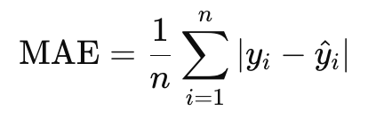
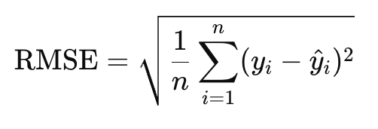
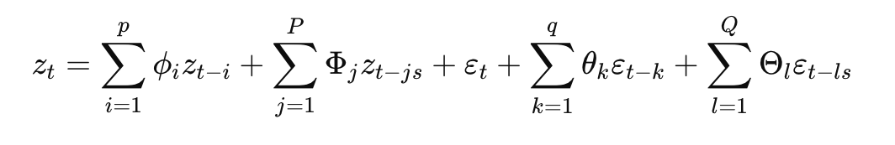
Evaluation and Baseline Models
Evaluation Metrics: Mean Absolute Error
Root Mean Square Error
Baseline Models: Naive Forecast
S-ARIMA Model

Slide 9
Results with the Standard LSTM Model
Naive Model | Mean Absolute Error: 42.031 Root Mean Square Error: 75.72
S-ARIMA Model | Mean Absolute Error: 41.57 Root Mean Square Error: 68.707
LSTM Model | Mean Absolute Error: 38.55 Root Mean Square Error: 70.92

Slide 10
Possible Improvements
Decompose the Time Series: We could decompose the data in to two time series, the trend and the seasonality. Train a separate LSTM model for each of those time series and then train a Neural Network Model to aggregate the two forecasts into the final forecast.
Additional Data: LSTM models can take multiple time series as input. Hence we could also use train the model with time series that are correlated with rainfall like, like wind speed data or temperature data.
Include Geographical: States that are close to each other will have similar rainfall patterns, instead of training each state separately, we could train states that are close to each other together.

Slide 11
References
Colah’s Blog, Understanding LSTM Networks, https://colah.github.io/posts/2015-08-Understanding-LSTMs/
Carnegie Mellon University, Introduction to Deep Learning Spring 2022, Lecture 15: Recurrent Network, Stability Analysis and LSTMs, https://www.youtube.com/watch?v=--2opBSVCfM&t=918s
Government of India, Area Weighted Monthly, Seasonal and Annual Rainfall from 1901-2015, https://www.data.gov.in/resource/area-weighted-monthly-seasonal-and-annual-rainfall-mm-36-meteorological-subdivisions-1901

